Slide 1
Hierarchical Clustering

Slide 2
Hierarchical clustering is another unsupervised machine learning algorithm, which is used to group the unlabeled datasets into a cluster and also known as hierarchical cluster analysis or HCA.
In this algorithm, we develop the hierarchy of clusters in the form of a tree, and this tree-shaped structure is known as the dendrogram.

Slide 3
The hierarchical clustering technique has two approaches:
Agglomerative: Agglomerative is a bottom-up approach, in which the algorithm starts with taking all data points as single clusters and merging them until one cluster is left.
Divisive: Divisive algorithm is the reverse of the agglomerative algorithm as it is a top-down approach.

Slide 4
Agglomerative Hierarchical clustering
The agglomerative hierarchical clustering algorithm is a popular example of HCA. To group the datasets into clusters, it follows the bottom-up approach.
It means, this algorithm considers each dataset as a single cluster at the beginning, and then start combining the closest pair of clusters together. It does this until all the clusters are merged into a single cluster that contains all the datasets.
This hierarchy of clusters is represented in the form of the dendrogram.

Slide 5
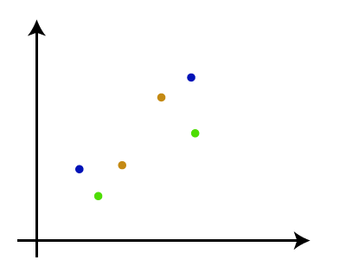
How the Agglomerative Hierarchical clustering Work?
Step-1: Create each data point as a single cluster. Let's say there are N data points, so the number of clusters will also be N.

Slide 6
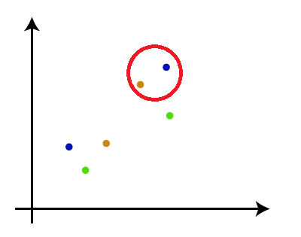
Step-2: Take two closest data points or clusters and merge them to form one cluster. So, there will now be N-1 clusters.

Slide 7
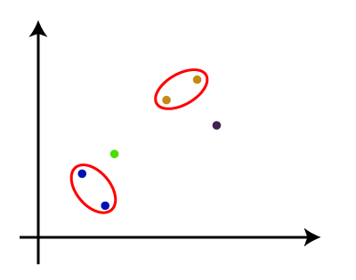
Step-3: Again, take the two closest clusters and merge them together to form one cluster. There will be N-2 clusters.

Slide 8
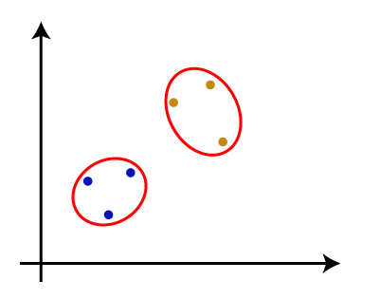
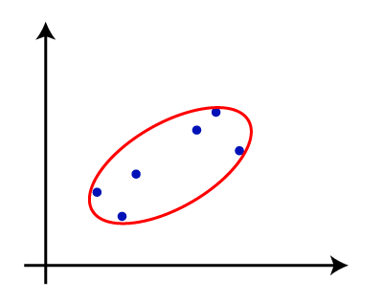
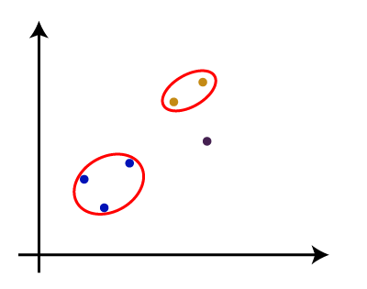
Step-4: Repeat Step 3 until only one cluster left. So, we will get the following clusters. Consider the below images:

Slide 9
Step-5: Once all the clusters are combined into one big cluster, develop the dendrogram to divide the clusters as per the problem.

Slide 10
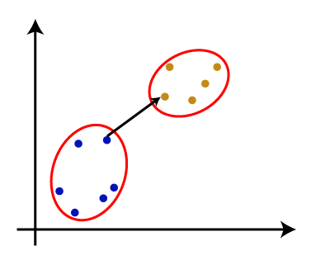
Measure for the distance between two clusters
Single Linkage: It is the Shortest Distance between the closest points of the clusters.

Slide 11
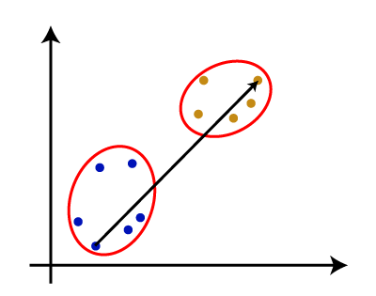
Complete Linkage: It is the farthest distance between the two points of two different clusters. It is one of the popular linkage methods as it forms tighter clusters than single-linkage.

Slide 12
Average Linkage: It is the linkage method in which the distance between each pair of datasets is added up and then divided by the total number of datasets to calculate the average distance between two clusters.
It is also one of the most popular linkage methods.

Slide 13
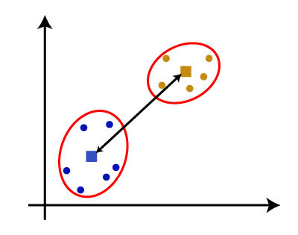
Centroid Linkage: It is the linkage method in which the distance between the centroid of the clusters is calculated.

Slide 14
Ward’s Method: It uses squared error to compute the similarity of the two clusters for merging.
Ward’s Method tries to minimize the increase in squared error and maintains compact clusters.
Initial Step: Each data point is treated as an individual cluster.
Merging Criteria: At each step, the algorithm merges the two clusters that result in the smallest increase in the total within-cluster variance (sum of squared errors, SSE).

Slide 15
Computation of SSE:
The SSE for a cluster is computed as the sum of squared Euclidean distances between each data point and the cluster centroid.
When two clusters C1​ and C2​ are merged into a new cluster C3​, the SSE increases.
Ward’s method chooses the pair of clusters that result in the smallest increase in SSE.

Slide 16
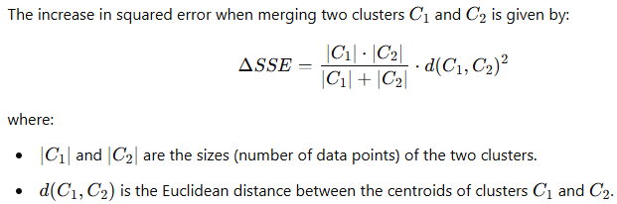

Slide 17
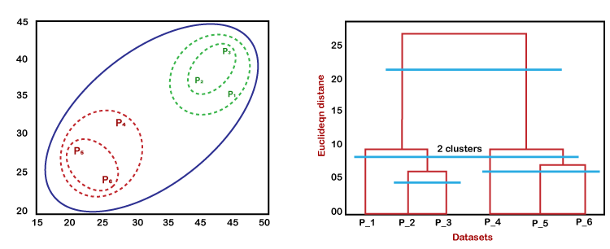
Woking of Dendrogram in Hierarchical clustering
The working of the dendrogram can be explained using the below diagram:

